Slide 1

Computing GCSE CA
Task 3 - A453 – ISBN Code Generator
Kenneth Cajigas

Slide 2

INTRODUCTION

Slide 3
Task 3 Requirements
ISBN or International Standard Book Numbers are used to identify books. One ISBN system uses 10 digits plus a check digit to identify a book. For example:
If the 10 digit book number is 0241034812 then we multiply the first digit in turn by 11, then 10 etc.
If this process is repeated for the 11 digit number, (multiplying the last digit by 1), the total of the digits will divide exactly by 11.
If the remainder is 1 the check digit would be 10, in this case we use the letter X to represent 10.
If the remainder is 0, then the check digit will be 0.
Create a program that will take in a 10 digit number and calculate the correct 11 digit ISBN.
Your program should only accept valid data, i.e.
• the number entered is the correct length
• only contains the digits 0 to 9.

Slide 4
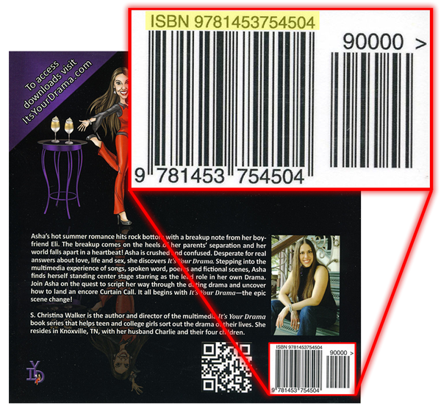
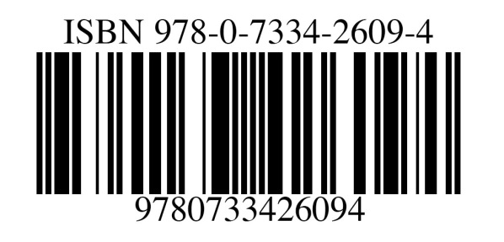
What is a ISBN?
ISBN numbers are used in our everyday lives
They can be found when buying books and many other things from retailers
It helps the computer to quickly identify what the item is and it is easy to identify what item the person is looking for
An ISBN is also known as a International Standard Book Number

Slide 5
Group Discussion
In our group discussion, we discussed the requirements of the ISBN generator. These included:
The ISBN generator should be able to handle a 10 digit input from the user
If the input is no equal to 10 digits, then the program should be able to output an error message saying the input is not valid
Also, the program should be able to multiply each number inputted in the code separately to be able to generate the check digit.
Once the check digit is calculated, it should be able to add it to the existing ISBN input the user has entered.

Slide 6
The Success Criteria
To able to succeed in completing the code the following things must be done:
Create a program that will take in a 10 digit number and calculate the correct 11 digit ISBN.
The program should only accept valid data for example:
The number entered is the correct length
Only contains the digits 0 to 9.
The code must also be able to know what the length of the input entered is
If the remainder is 10, then the check digit should be ‘X’
If the remainder is 0 then the check digit should be ‘0’

Slide 7
Algorithms
Flowchart and Pseudocode

Slide 8
The pseudocode
Print ‘Please enter your 10 digit ISBN number’
Input 10 digit ISBN number
While ISBN length 10:
If yes:
Break
Else:
Print ‘Please try again, you didn’t enter a 10 Digit ISBN number’
Continue
Is ISBN an integer?
If yes:
Break
Else:
Print ‘Invalid characters! Try again’
Continue
Calculate (Result) N[1]*11, N[2]*10, N[3]*9, N[4]*8, N[5]*7, N[6]*6, N[7]*5, N[8]*4, N[9]*3, N[10]*2
Divide the result by 11
Do (FINAL) 11 – remainder (R)
If R == 10:
THEN FINAL=‘X’
If R == 0:
THEN FINAL=‘0’
Else:
Print Result + FINAL

Slide 9
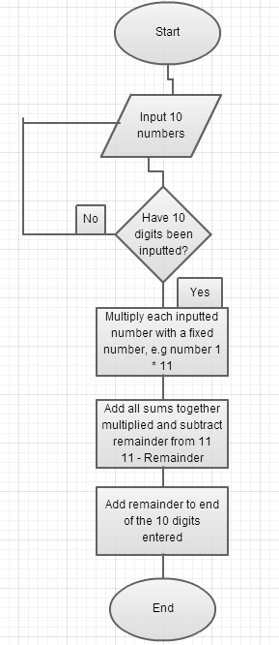
The Flowchart
A decision whether 10 digits have been inputted, if not go in a loop
This is where the multiplication occurs, e.g. N1*11
Adds the result of 11 – Remainder to the end of the inputted ISBN number

Slide 10
The code development
I will only annotate code only when there are differences in the code

Slide 11
Change log / Development of the code version 1 - 3
Version 1:
Version 1 of the code was very basic in completing a way of doing an ISBN generator. It was very complicated however because it required the user to enter each ISBN number separately.
Version 2:
Version 2 was much different and this time it did not require the user to require each separate number of the ISBN. It was also able to validate the type of input entered and it gave out errors when they were found.
Version 3:
Although the code was able to have a validation method, it was still a problems with version 2. The code version 3 fixed many issues and I did not find any errors

Slide 12
The code development version 1
The first thing that seemed simple was having each ISBN number inputted separately by the user.
The reason for entering each number separately by the user is because the code would do each input multiplied by a fixed number e.g.
Input 1 = 2
Do Input1*11
This solution worked well and was able to do its job efficiently

Slide 13
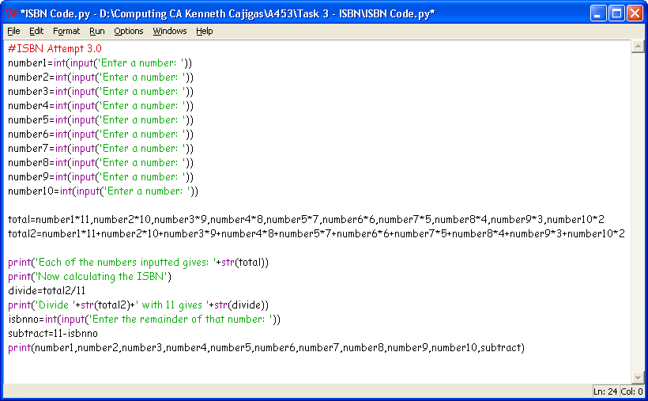
The code – Version 1 step 1
Make the user enter the 10 numbers
Make sure it is a integer, so it can only accept whole numbers

Slide 14
The code – Step 2
Call the variables total and total 2.
Total 1 for the multiplication and total 2 for adding all the sums together

Slide 15
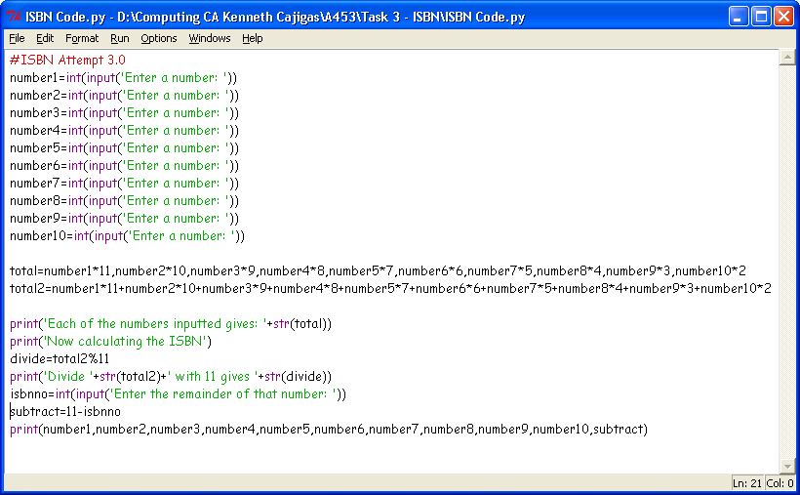
The code – Step 3
Integrate the variables into the main code.
The ‘%’ calculates the remainder of the sum total2/11

Slide 16
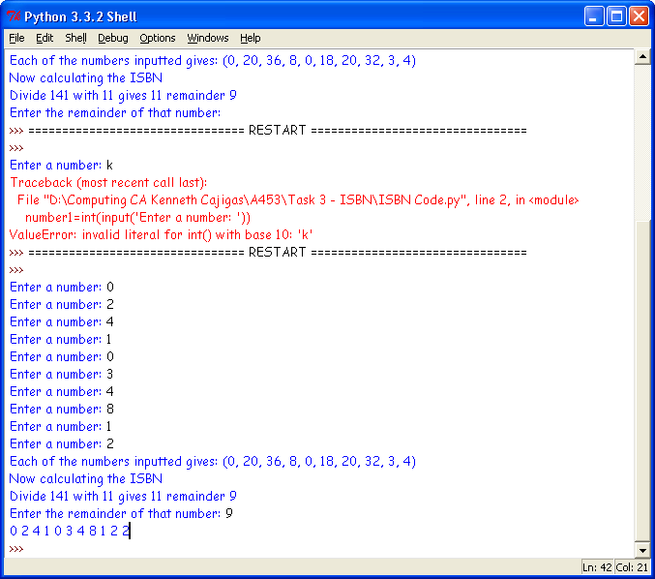
The code – Step 4
I needed to have an error message or loop if this happened
Overall, the code did give the ISBN number, but it needed to be simpler

Slide 17
The code version 1 feedback
There were many unnecessary variables that were not needed in my first code
The code needed to be able to count the length of the numbers inputted
It also needs to put the input into a list using the list function to simplify how the code worked.
This made it easy for the user to input an ISBN number without having to do an input multiple times
It also needed a loop until the program accepted that 10 numbers were entered with no characters

Slide 18
The code version 2
The code here was finally able to have a validation check, it was much more shorter and efficient and followed all the feedback I was given
It was able to tell the difference between a character and a number
My new code was also able to count the length of the code while knowing when an input length is not equal to 10.

Slide 19
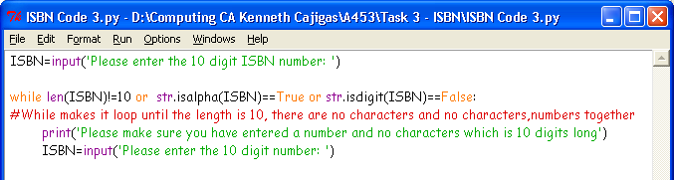
The code version 2
Use the ‘len’ function to verify the length of characters entered, and if not equal to 10, give error
If the input has characters, then give the error
If the input also has no digits, then give an error

Slide 20

The code version 2
Using the list function, it allows the program to separate each number inputted and multiplies it by a fixed number
Starts from 0 because the list function does

Slide 21
The code Version 2
The variable ‘addition’ adds the multiplication sums together

Slide 22
The ‘%’ finds the remainder of the sum of all the numbers multiplied by 11
If the check digit turns out to be 10, then make the check digit X
Adds the ISBN number inputted and check digit together

Slide 23
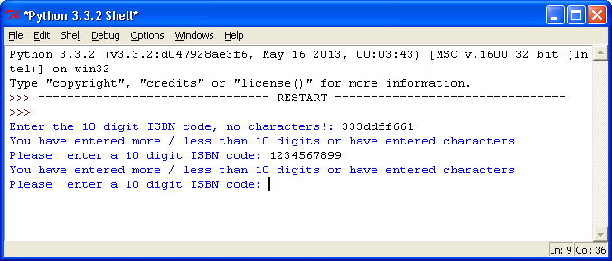
The code version 2 feedback
The code was good simple. It was able to handle inputs and get an ISBN number
However there were problems with the code and it was not able to validate each input made correctly. Here is an example:
The code here could tell that there was a problem with the input however when a correct amount of numbers were entered, the code didn’t recognize it

Slide 24
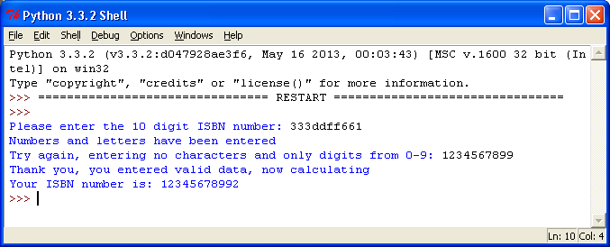
The final code version 3
The final code can be found on the next slide
It gives out different errors to different inputs entered. This can be seen in the test plan and its evidence
Although the code is much longer, it fixed the problem that I had with the previous version, here is the evidence:
The code was finally able to tell when an input was valid or invalid and it also gave a message when the input was accepted.

Slide 25
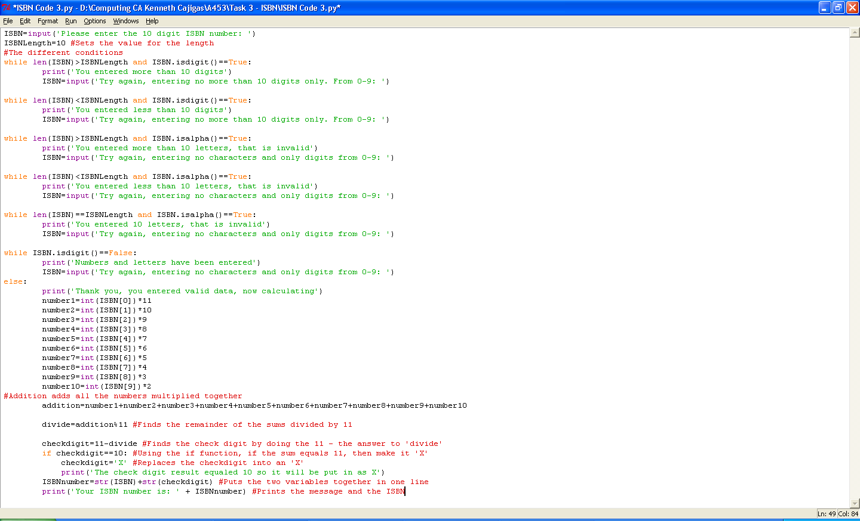
The final code includes the different condition scenarios and its different error messages
ISBN.isdigit()==False
Makes it loop if it is numbers and letters
Adds a verification message saying that the input was accepted.

Slide 26
The test plan
I am going to test my code by entering different ISBN numbers these include:
5325672104 should give 53256721044
4353543768 should give 43535437687
8124743719 should give 81247437191
I will also test my code by entering numbers and letters, numbers that are not in the length of 10, and letters only to see how my code will react.
If there are any problems, then I will annotate the changes I make to my code and its effect.

Slide 27
Test plan table
Test number Valid/Invalid | Input | Data | Expected outcome
1: Invalid | 1234567abc | Numbers and letters | Should fail with a reject message
2: Invalid | abcdefgjik | Letters | Should fail with a message ‘Letters entered’
3: Valid | 0699183204 | Numbers | Should output 06991832049
4: Invalid | 123222556678 | Numbers | Should output ‘More than 10 numbers entered’
5: Invalid | 1265 | Numbers | Should output ‘Less than 10 numbers entered’
6: Valid | 0155853234 | Numbers | Should output 0155853234X

Slide 28
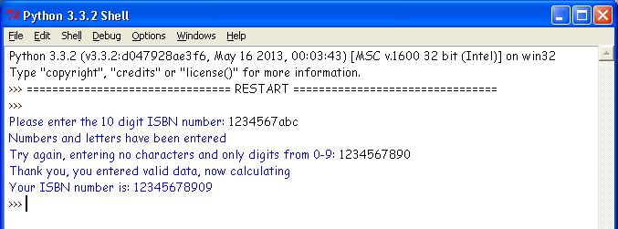
Results:
1: Invalid | 1234567abc | Numbers and letters | Should fail with a reject message
* The second input allowed the input that was entered.

Slide 29
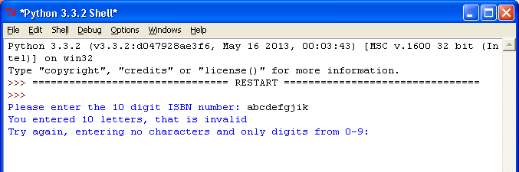
Results:
2: Invalid | abcdefgjik | Letters | Should fail with a a message ‘Letters entered’ ‘Try again’

Slide 30
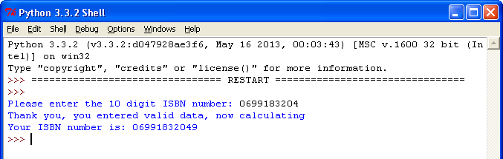
Results:
3: Valid | 0699183204 | Numbers | Should output 06991832049

Slide 31
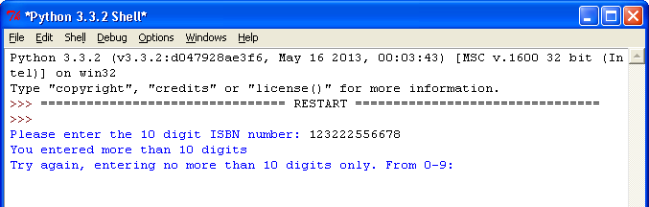
Results:
4: Invalid | 123222556678 | Numbers | Should output ‘More than 10 numbers entered’

Slide 32
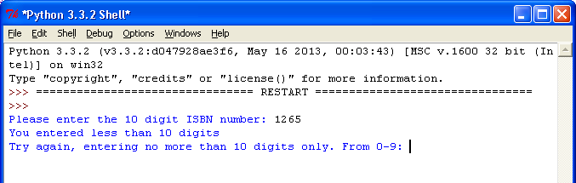
Results:
5: Invalid | 1265 | Numbers | Should output ‘Less than 10 numbers entered’

Slide 33
In the success criteria that has been set, my code meets:
Yes, my code was able to meet all of the success criteria's that were set before developing the code. These were:
Be able to open a .csv file
Accept and handle an input
Have a verification check to see whether the category to search in is correct and to check if the option entered is valid
Be able to read the .csv file provided
Search inside the .csv file
Output an error message if the input entered by the user doesn’t match the records in the .csv file

Slide 34
ending
Conclusion, Evaluation (Of code)

Slide 35
Evaluation
I found that the code was working fully and passed all the tests that I did
The code however was very long and I could have shortened it to add efficiency to the code
Although it was longer then usual, it was able to know when an input was valid or invalid and it also gave a message when the input was accepted.

Slide 36
Conclusion
Overall I found that making the ISBN code generator was a long process
I found that you have multiple conditions on a single line using ‘and’ + ‘or’
I enjoyed creating the code for the ISBN and I learned many new things such as the .isdigit function, the .isalpha function and many more.
If I could redo the code, I would try to shorten the amount of lines my code had and also simplify the amount of functions used
Notes:
Done!

